Slide 1


Slide 2



MINOR PROJECT ZEROTH REVIEW

Slide 3
Detection of kidney stone using image processing techniques
TEAM MEMBERS:
VASANTH.P (927621BEC234)
VISHAL.G(927621BEC242)
SIBI.V.B (927621BEC199)
YUVA SARAVANAN.S(927621BEC248)
GUIDED BY :
Mr.S.MOHANRAJ
(AP/ECE)

Slide 4
SYNOPSIS
INTRODUCTION
PROBLEM STATEMENT
OBJECTIVES
EXISTING SYSTEM
BLOCK DIAGRAM
REFERENCES
CONCLUSION

Slide 5
INTRODUCTION
The kidney is a vital organ in the human body. Kidney stones have been a widespread problem in recent years.
Kidney stones are solid pieces of material that form as a result of minerals in the urine. They are caused by a combination of genetic and environmental factors.

Slide 6
PROBLEM STATEMENT
Kidney-stones can be a life-threatening situation. Therefore, timely diagnosis is very essential. To ensure the efficacy of surgical operations, it is necessary to precisely diagnose kidney stones.
Speckle noise and poor contrast in ultrasound pictures of the kidney make it difficult to detect stones. As a result, doctors may find it tough and confusing to recognize tiny kidney stones and their nature.
To solve this problem, an image processing-based detection technique is proposed to determine the exact location of the stones.

Slide 7
OBJECTIVES
The main objective of this project is to detect the kidney stone from the digital ultrasound image of the kidney by performing various image processing techniques.
Due to the varied texture and existence of speckle noise, detecting regions of interest in ultrasound pictures is a difficult process.

Slide 8
EXISTING SYSTEM
Several image-based screening technologies are now available for kidney stones, which are summarized in this section.
A person’s life might be placed at risk if an incorrect diagnosis is made of kidney stones in the body.
Many imaging-based screening approaches are available to detect kidney stones today, and the following section summarizes these.

Slide 9
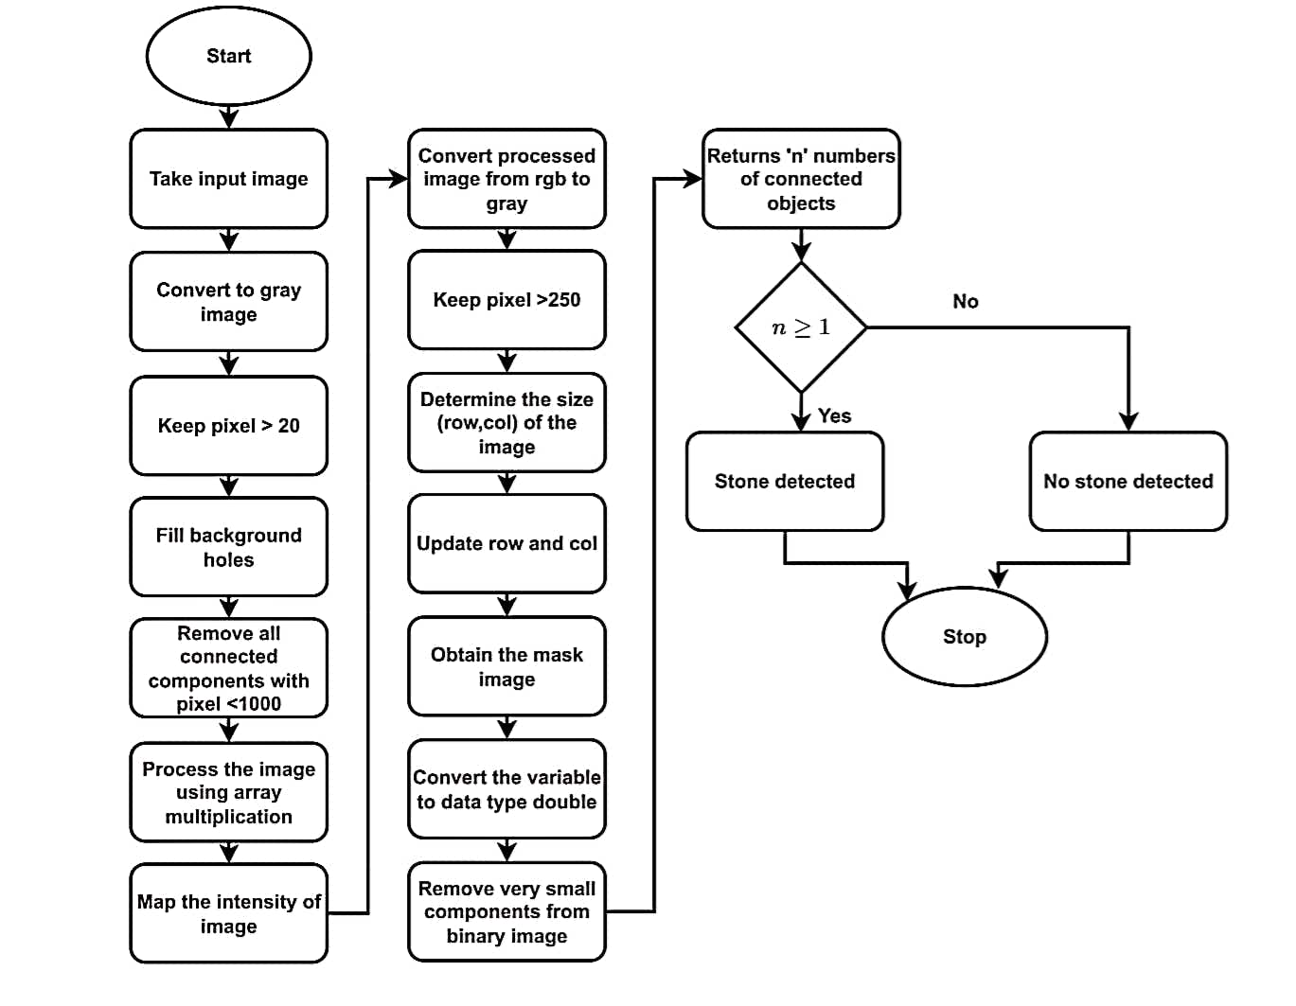
BLOCK DIAGRAM

Slide 10
REFERENCES
[1] Raja R A and Ranjani J J 2013 Segment based detection and quantification of kidney stones and its symmetric analysis using texture properties based on logical operators with ultra sound scanning International Journal of Computer Applications.
[2] Manikandan S and Rajamani V 2008 A mathematical approach for feature selection & image retrieval of ultra sound kidney image databases European Journal of Scientific Research.
[3] Hafizah W M and Supriyanto E 2012 Automatic generation of region of interest for kidney ultrasound images using texture analysis International Journal of Biology and Biomedical Engineering .
[4] Sun Y N, Lee J S, Chang J C and Yao W J 1994 Three-dimensional reconstruction of kidney from ultrasonic images.
[5] Hao X, Gao S and Gao X 1999 A novel multiscale nonlinear thresholding method for ultrasonic speckle suppressing IEEE Trans. Med.

Slide 11
CONCLUSION
Pre-processing, fragmentation, and the feature extraction on the input image are the basic and key functions of our proposed scheme for spotting the presence of kidney stones.
The feature extraction approach was used to measure the precise coordinates of the stone and the overall appearance of the stones created from the picture. Doctors could intelligently diagnose kidney stones following the surgery by using a composite of all three methods.

Slide 12


